Slide 1
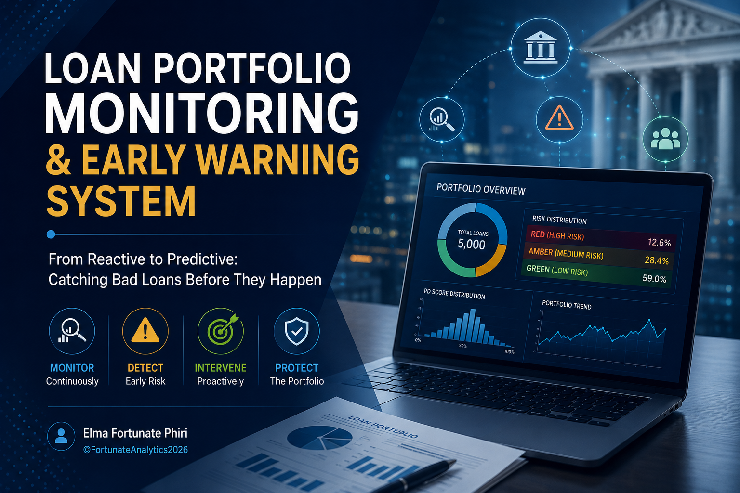
Notes:
Welcome everyone. My name is Elma Fortunate Phiri, and today I'm going to walk you through a project I built: a Loan Portfolio Monitoring and Early Warning System. This is a proof of concept built on synthetic data, but the problem it solves is very real. By the end of this talk, I want you to walk away thinking about how predictive analytics could change the way we manage credit risk. Let's get started.

Slide 2
“Every loan that goes bad
had warning signs.”
Most banks only see them when they become NPL.
©FortunateAnalytics2026
Notes:
OPENING HOOK — deliver this slowly and confidently. Pause after the first line. 'Every loan that goes bad had warning signs. Most banks only see them in the rear-view mirror. I built a system that puts those warning signs on the windshield.' Let that land. Then move to the next slide. Don't rush.

Slide 3
The Reality of Loan Risk Management
📋
⏰
💸
Reactive, Not Proactive
Lag in Detection
The Cost of Acting Late
Risk is assessed at origination. After that, monitoring is mostly manual and periodic.
By the time a loan is classified as Non-Performing, losses are already locked in.
Late intervention means higher provisions, write-offs, and regulatory penalties.
©FortunateAnalytics2026
Notes:
Set the scene. Banks today manage loan risk the old way: evaluate at origination, then hope for the best. The problem is lag. Monitoring is periodic and often manual. By the time a loan flags as non-performing, it's too late to intervene meaningfully — the bank is already provisioning for losses. This is the gap I wanted to close.

Slide 4
The Question this project set out to answer
What if we could flag a borrower
deteriorating 3–6 months before default?
01
Detect risky loans early
02
Monitor portfolio health continuously
03
Support intervention decisions
©FortunateAnalytics2026
Notes:
This is the core question. Not 'did this loan default?' but 'IS this loan heading toward default, and can we see it coming?' My three objectives were: one, detect risky loans early. Two, monitor portfolio health so management can see the big picture. Three, support the people on the ground — relationship managers — in deciding who to call. These three goals shaped every design decision in the system.

Slide 5
Dataset Overview
Loan portfolio dataset containing 5000 loan records. This dataset is designed for credit risk assessment and loan performance monitoring
Borrower Profile
Loan Characteristics
Credit Score, Annual Income, Employment, Province, Sector
Loan Amount, Tenor, Interest Rate, Collateral Type & Value, Loan Product
Repayment Behaviour
Derived Ratios
Days Past Due (DPD), Missed Payments, Bank Balance Trend, Revolving Utilisation
LTV (%), DTI (%), DSCR,
©FortunateAnalytics2026
Notes:
This is a synthetic dataset built to replicate a real loan portfolio. One thing that stood out immediately in the data: roughly half the portfolio was already in Special Mention or Watch — these are loans not yet defaulted, but already showing deterioration. That's exactly the population an Early Warning System is designed for. The dataset included borrower profiles, loan terms, repayment behaviour, and I engineered additional financial ratios — LTV, DTI, and DSCR — that banks use every day.

Slide 6
What the Data Told Us
📊 Credit Score = Strongest Signal
Provincial Loan Distribution
The correlation analysis confirmed credit score as the best single predictor of repayment. Higher scores, lower risk.
.
Harare has the most borrowers at 26.82% followed by Bulawayo at 14.76% then Midlands at 13.24%
💳 Borrower’s Sector
🏦 Income & Collateral Less Predictive
The Agricultural Sector makes up 17.42% of the borrowers followed by Retail at 16.36% then Manufacturing at 9.64%
Surprisingly, income and collateral value were weaker separators. Payment behaviour mattered far more than demographics.
©FortunateAnalytics2026
Notes:
Before building anything, I spent time exploring the data. Four things stood out. One: Credit score is the single strongest predictor. Exactly as theory predicts — good. Two: Days Past Due is a beautiful monotonic signal. As the loan deteriorates, DPD rises in a clear, trackable way. Three: Missed payments compound risk. Two or more missed payments is a strong red flag. Four — and this surprised me: income and collateral were much weaker predictors than I expected. Behaviour beats demographics. That shaped how I built the EWS.

Slide 7
System Architecture Overview
🚦
🤖
📊
🔧
🔧
Data &
Feature Eng.
EWS Flags
& Scoring
PD Model
(Random Forest)
Model
Demonstration
Data Collection &
Cleaning
LTV, DTI, DSCR
+ Risk Flags
Green / Amber /
Red Bands
Borrower PD
Score (0–100%)
Model
User Function
©FortunateAnalytics2026
Notes:
Here's the system in four stages. Stage one: Data ingestion and feature engineering — I calculated LTV, DTI, DSCR, and cleaned and encoded all the categorical variables. Stage two: The Early Warning System — six binary flags combined into a composite risk score, which assigns each borrower a traffic light: Green, Amber, or Red. Stage three: The PD model — a Random Forest classifier that predicts the probability a borrower will default. Stage four: The portfolio dashboard — rolling everything up from individual borrower to the full portfolio view. These four stages work together to give a bank a complete picture.

Slide 8
Early Warning System: 6 Risk Flags
🚩
DPD > 30 days
🚩
Missed Payments ≥ 2
🚩
High LTV (> 80%)
Borrower is already behind
Repeated failure to pay
Collateral barely covers loan
🚩
High DTI (> 40%)
🚩
Low DSCR (< 1)
🚩
High Revolving Util.
Debt burden too heavy
Income can't cover repayments
Already stretched on credit
©FortunateAnalytics2026
Notes:
These are the six binary flags at the heart of the Early Warning System. Each one fires a 1 or a 0. I chose these six because they each capture a different dimension of risk: payment behaviour, leverage, income adequacy, and credit utilisation. None of them alone is a death sentence. But when you start stacking them, the picture gets very clear. That's the insight behind the composite score.

Slide 9
Composite Risk Score → Traffic Light
Risk Score = Sum of all 6 flags (0 to 6)
🟢
🟡
🔴
GREEN
AMBER
RED
Score: 0 – 1
Score: 2 – 3
Score: 4 – 6
Low risk. Monitor normally.
Watch closely. Consider proactive outreach.
High risk. Immediate intervention needed.
©FortunateAnalytics2026
Notes:
This is where the system becomes actionable. I sum up all six flags into a score from 0 to 6. Then I assign a traffic light. Green — score 0 or 1. The borrower is fine. Routine monitoring. Amber — score 2 or 3. Something is starting to move. Watch this borrower. Consider a call. Red — score 4 or above. Multiple stress signals are firing at once. Act now. This is deliberately simple — because simplicity gets used. A complicated scoring model that no one understands doesn't protect the portfolio.

Slide 10
Probability of Default Model
Model Comparison Summary:
Model | Accuracy | AUC Score
Logistic Regression | 61.2% | 0.6862
Decision Tree | 87.4% | 0.8893
Random Forest | 89.8% | 0.9106
Gradient Boosting | 89.7% | 0.9073
Our Model was trained using 4 different models. Random Forest was the best performing model with an accuracy of 89.8% and AUC Score of 0.9106
©FortunateAnalytics2026
Notes:
Let me give you one concrete finding from the analysis. When I compare borrowers with high debt-to-income ratios — above 40% — against those with manageable debt, the NPL rate jumps from 15.6% to 26.2%. That's a 68% increase in default likelihood. And it's measurable. It's calculable at the point of monitoring, not just at origination. This is why DTI is one of the six EWS flags.

Slide 11
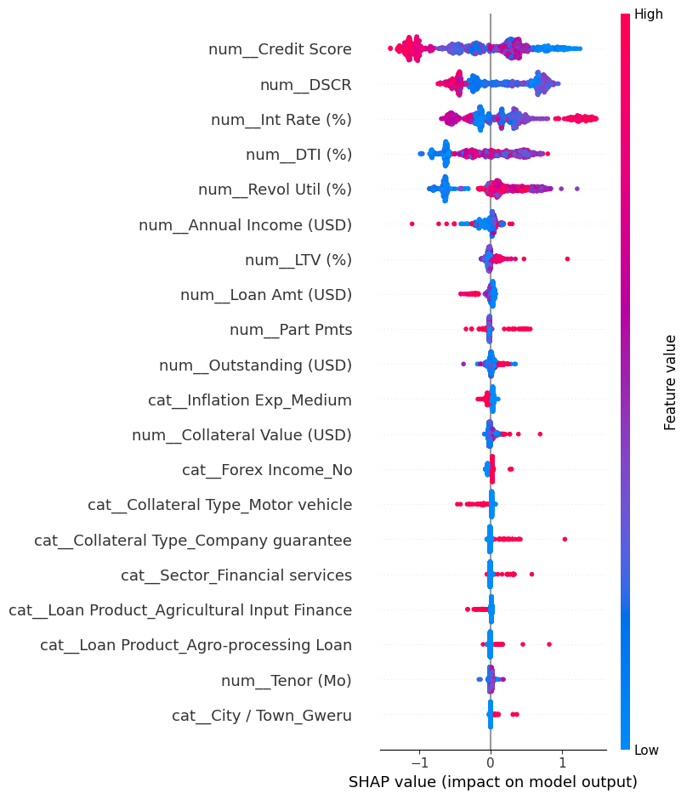
Model Explainability
Each dot is one borrower. Red = high feature value. Dots on the right = pushes toward default.
©FortunateAnalytics2026
Notes:
For the PD model, I tested three algorithms: Logistic Regression as a baseline, Decision Tree for interpretability, and Random Forest. Random Forest came out on top. It handles mixed data types well, it's robust to noisy features, and critically — it supports SHAP explainability, which I'll show you in a moment. In a production environment, I would also explore XGBoost and calibrated probability outputs. But for this PoC, Random Forest delivered strong results.

Slide 12
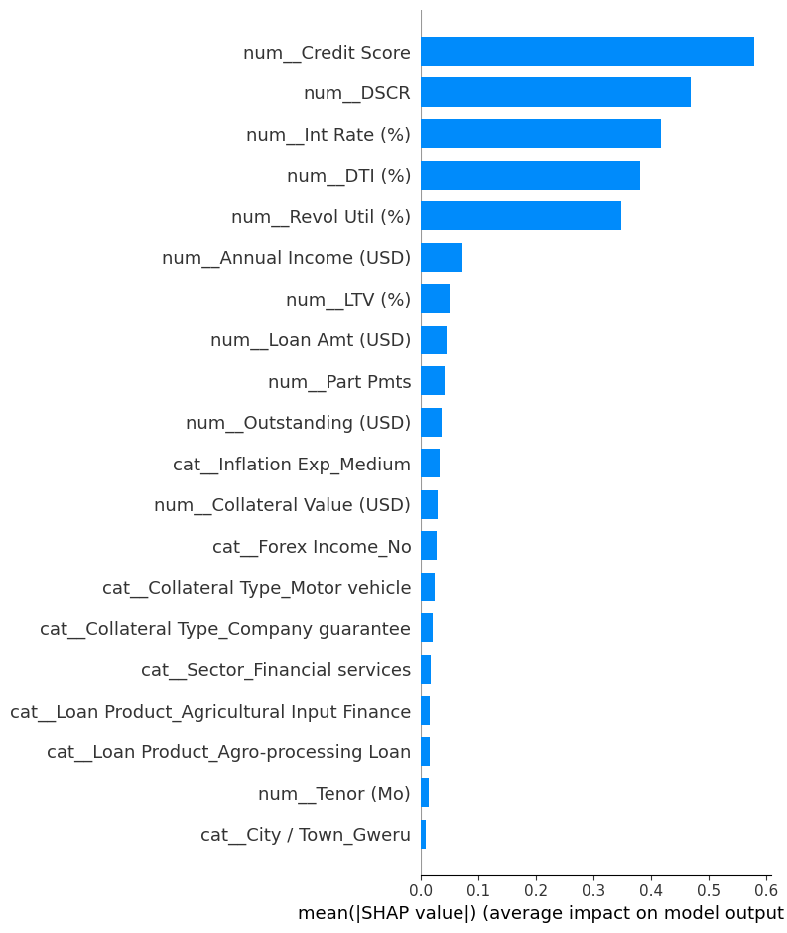
Model Explainability
Top Drivers
Using the best-performing model (Random Forest) to explain which features drive default predictions.
©FortunateAnalytics2026
Notes:
For the PD model, I tested three algorithms: Logistic Regression as a baseline, Decision Tree for interpretability, and Random Forest. Random Forest came out on top. It handles mixed data types well, it's robust to noisy features, and critically — it supports SHAP explainability, which I'll show you in a moment. In a production environment, I would also explore XGBoost and calibrated probability outputs. But for this PoC, Random Forest delivered strong results.

Slide 13
The System in Action: Two Borrowers
🟢 Borrower A
🔴 Borrower B
Credit Score: 810
Credit Score: 340
DSCR: 2.8
DSCR: 0.6
DTI: 18%
DTI: 85%
Revol Util 92%
Revolt Util: 30%
LTV: 43%
LTV: 180%
Risk Band: GREEN
EWS Score: 1 → Monitor normally
Risk Band: RED
EWS Score: 5 → Intervene immediately
©FortunateAnalytics2026
Notes:
Let me make this concrete with two borrowers. Borrower A: Credit score 720, no days overdue, one missed payment, DTI 32%, LTV 65%. EWS score: 1. Green. This person is fine — monitor normally. Borrower B: Credit score 480, 52 days past due, three missed payments, DTI 58%, LTV 91%. Five out of six flags are firing. EWS score: 5. Red. This borrower needs a call today. The system didn't wait for a formal review cycle. It flagged Borrower B the moment the data updated. That's the difference between reactive and predictive. Pause here. Let the audience sit with those two cards for a moment.

Slide 14
Business Impact
💰 Lower Loan Losses
📐 Accurate Provisioning
Earlier flagging enables intervention before default is certain. Restructuring a loan costs less than writing it off.
IFRS 9 requires forward-looking credit loss estimates. An EWS score maps directly to Stage 1/2/3 staging.
👥 RM Prioritisation
📈 Portfolio Intelligence
Relationship managers get a ranked list of who to call — not 500 loans to review manually.
Management gets a real-time view of concentration risk, stress by branch and sector, and total exposure at risk.
©FortunateAnalytics2026
Notes:
So what does this mean in business terms? One: lower loan losses. When you catch a borrower early, you can restructure, extend, or reduce exposure before it becomes a write-off. Restructuring is always cheaper than default. Two: more accurate provisioning. IFRS 9 requires banks to hold provisions based on expected credit losses. An EWS score maps naturally to Stage 1, 2, and 3 staging — that's a direct regulatory benefit. Three: RM prioritisation. Instead of a relationship manager manually reviewing hundreds of loans, they get a prioritised list of who needs attention today. Four: portfolio intelligence. Senior management can see concentration risks before they become systemic problems.

Slide 15
Future Developments
01
Real Data Integration
02
API Deployment
Connect to core banking system. Remove synthetic data. Re-validate model on live portfolio.
Deploy the model as a REST API for integration with core banking systems.
03
Time-Series Monitoring
04
Automated Alerts
Track borrower risk score month-over-month. Flag when score moves from Green to Amber.
Push Red alerts to relationship managers via dashboard or email. Close the intervention loop.
©FortunateAnalytics2026
Notes:
This is a proof of concept — but it's a credible foundation for a production system. The four next steps are: integrate real data from the core banking system, fix the data leakage issue I identified, add time-series monitoring so we track score movements over time, and automate the alerts so relationship managers get notified when a borrower crosses into Red. None of these are technically complex. The hard part — defining the flags, validating the model logic, building the portfolio view — is already done.

Slide 16
Banks don't lose money overnight. Borrowers deteriorate gradually, and those warning signs are visible long before default. The challenge isn't finding the signals, it's acting on them early enough
Notes:
This is a proof of concept — but it's a credible foundation for a production system. The four next steps are: integrate real data from the core banking system, fix the data leakage issue I identified, add time-series monitoring so we track score movements over time, and automate the alerts so relationship managers get notified when a borrower crosses into Red. None of these are technically complex. The hard part — defining the flags, validating the model logic, building the portfolio view — is already done.

Slide 17

About
Elma Fortunate Phiri
Data Scientist | Harare, Zimbabwe
A Data Science graduate and aspiring Data Scientist based in Harare, Zimbabwe, with a passion for turning raw data into actionable business insights. She is currently seeking graduate opportunities in data science and analytics.
DEAL Cohort 1 Graduate
©FortunateAnalytics2026
Notes:
This is a proof of concept — but it's a credible foundation for a production system. The four next steps are: integrate real data from the core banking system, fix the data leakage issue I identified, add time-series monitoring so we track score movements over time, and automate the alerts so relationship managers get notified when a borrower crosses into Red. None of these are technically complex. The hard part — defining the flags, validating the model logic, building the portfolio view — is already done.

Slide 18
Thank You
Elma Fortunate Phiri
Loan Portfolio Monitoring & Early Warning System
💬
🔗
💻
Questions?
Connect
See the Code
Elma Fortunate Phiri | LinkedIn
LinkedIn
Notebook available — built in Python / Jupyter
©FortunateAnalytics2026
Notes:
CLOSING — deliver this with confidence. 'Thank you. Building this system taught me that the best early warning signals aren't exotic — they're the simple ones: how many days is someone overdue, how many payments have they missed, and what is their credit score telling us. The complexity is in the system that acts on those signals, not in finding them.' Then open for questions. Breathe. You've done the work — now enjoy the conversation.

